Slide 1

YEAR 11 GCSE INFORMATION EVENING
In today’s session:
The year ahead – what to expect
How to get the most out of every lesson.
How to revise effectively
How and when to apply for post-16
Questions to discuss:
What are the most common mistakes that students make when revising?
What are the most effective strategies to use?
PREPARE FOR
LEARNING
Questions to discuss:
When should you start to apply for colleges and sixth forms?
How many places should you apply for?
Star task:
Graham revises by reading over his book the night before each exam.
What advice would you give him to improve his grades further?

Slide 2

Success at GCSE:
The next year will be stressful.
There are high expectations of you and you will put high expectations on yourself.
When you are in the hall in May 2026, it will just be you.
But for the year, you are not alone, and your efforts will all be worth it!

Slide 3


Slide 4




















Roadmap For Year 11 – What does the year ahead look like?
November PPEs
March PPEs
Results Day
You have been studying and revising hard and now is the time to demonstrate your progress. These predicted grades will go to your prospective colleges and 6th Forms.
You are ready for the final ‘dress-rehearsal’ before the real thing. A chance to fine tune your knowledge, skills and understanding and check how your progress is developing.
In August, you will come in to school to collect your results. It should be an GREAT day to celebrate your achievements and to see your hard work paying off.
01
03
05
Post - 16 Applications
Start of Year 11
You have completed your academic review to start the year. You have set yourself targets and you are raring to go. After school intervention starts and you revise consistently each week.
You are making important and informed choices about your next steps after Deptford Green. What kind of career do you want to work towards? What qualifications do you need to study to make your dreams a reality?
GCSE Exams
02
04
In May and June it is time for the big event, your final GCSE exams! You have been working towards these during your 5 years at Deptford Green, make it count!
06

Slide 5
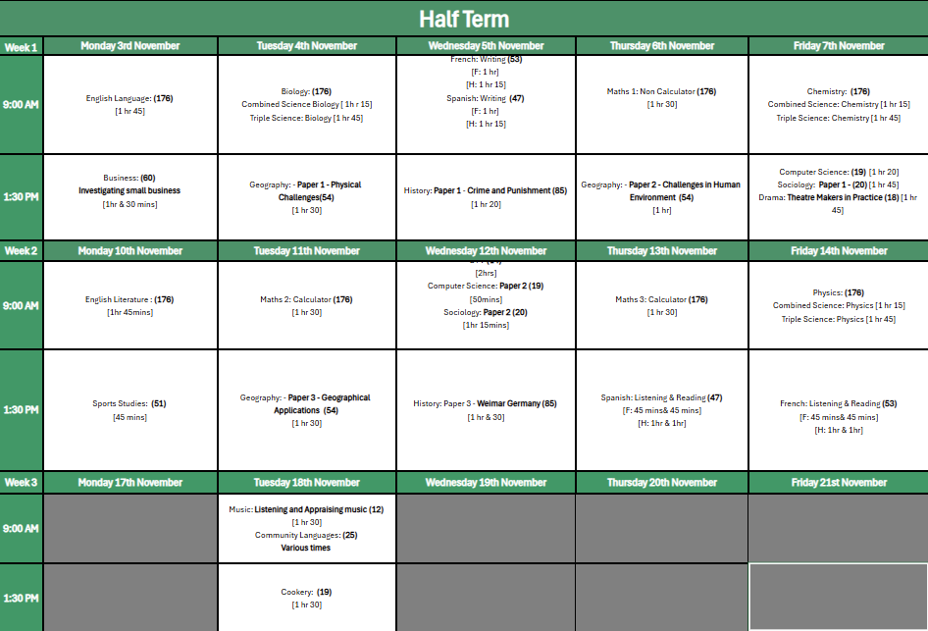
PPE TIMETABLE - NOVEMBER

Slide 6
EXAM BOARDS
Content & coursework can differ.
Revision guides and study sites differ.
Any outside tutoring should be exam board specific.
EXAM BOARD INFORMATION
EXAM BOARD | SUBJECTS
AQA | ENGLISH, SCIENCE, GEOGRAPHY
EDEXCEL (PEARSON) | MATHS, HISTORY, FRENCH, SPANISH, DT, DRAMA, BUSINESS STUDIES, ART, TEXTILES, PHOTOGRAPHY
OCR | SPORTS STUDIES, COMPUTER SCIENCE, MUSIC
EDUQAS | SOCIOLOGY
NCFE | FOOD & COOKERY

Slide 7
INTERVENTION SCHEDULE
These sessions are proven to make the difference.
Attendance is crucial.
If you can’t attend for any reason – let us know in advance.
MORNING INTERVENTION SCHEDULE AUTUMN 1
MONDAY | TUESDAY | WEDNESDAY | THURSDAY | FRIDAY
ASSEMBLY | MATHS SCIENCE | MATHS SCIENCE ENGLISH |  | ENGLISH
AFTER SCHOOL INTERVENTION SCHEDULE AUTUMN 1
MONDAY | TUESDAY | WEDNESDAY | THURSDAY | FRIDAY
SCIENCE | ENGLISH HISTORY GEOGRAPHY DT | ART MATHS TUTITION | MATHS | SOCIOLOGY TEXTILES PHOTOGRAPHY SPORTS STUDIES

Slide 8
WHAT
DIFFERENCE
DOES
MAKE
IT
?

Slide 9
QUICK QUIZ!
What is to considered to be ‘good’ attendance according to the UK government?
If your attendance was 94% over a year, how much school would you have missed?
If you miss two and a half weeks of school over a year, how many lessons would you have missed?
ABOVE 77%
ABOVE 87%
ABOVE 97%
TWO WEEKS
HALF A WEEK
ONE WEEK
60 LESSONS
75 LESSONS
40 LESSONS
ABOVE 97%
TWO WEEKS
75 LESSONS

Slide 10
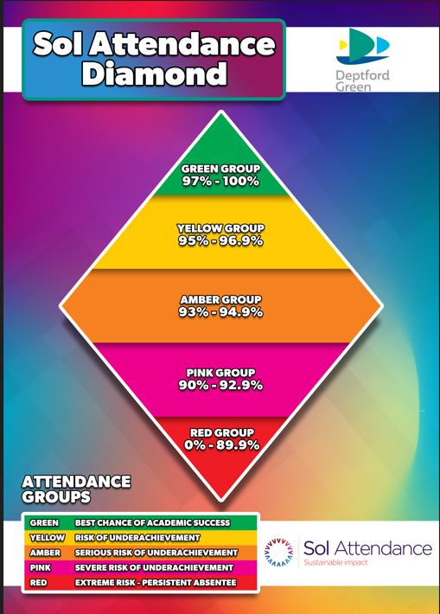
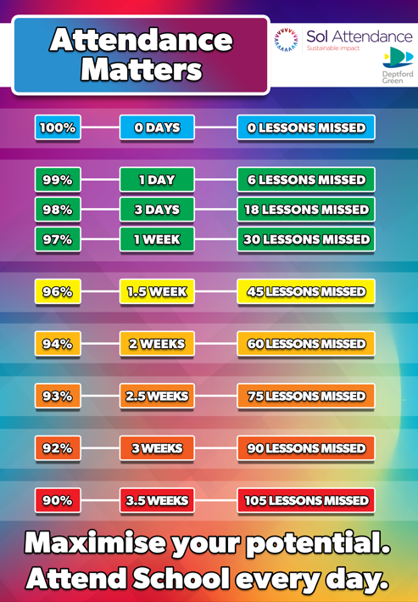

Attendance expectations

Slide 11
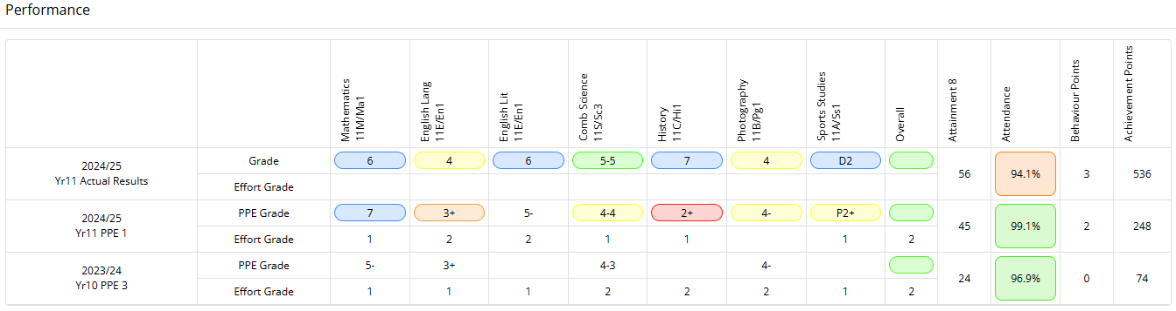

CASE STUDY
Student Profile
Joined late in Year 10
Attended every intervention including giving up core PE for extra History
Attended every master class and every half term intervention.

Slide 12
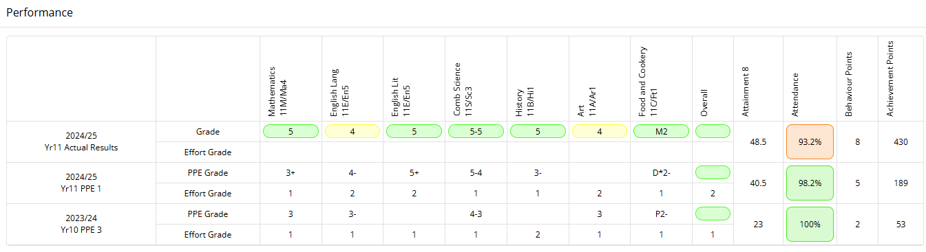
CASE STUDY
Student Profile
Joined late in Year 10
Attended every intervention including giving up core PE for extra History
Attended every master class and every half term.

Slide 13
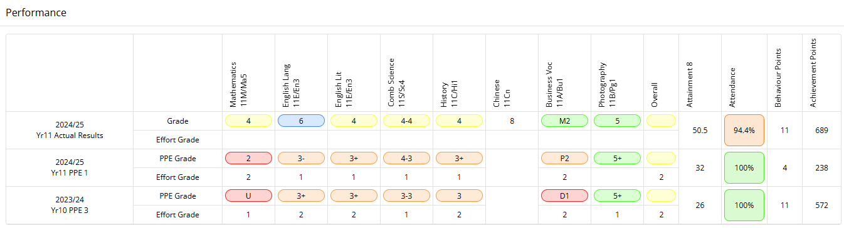
CASE STUDY
Student Profile
Joined the school in Year 7
Attended every intervention including giving up core PE for extra History
Attended every master class and every half term.

Slide 14
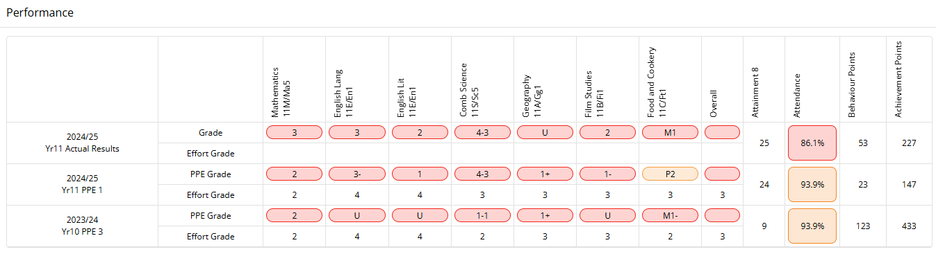
CASE STUDY
Student Profile
Joined the school in Year 7 – believed he could achieve on the day.
Did not attend intervention sessions offered
Did not improve effort over the years.

Slide 15
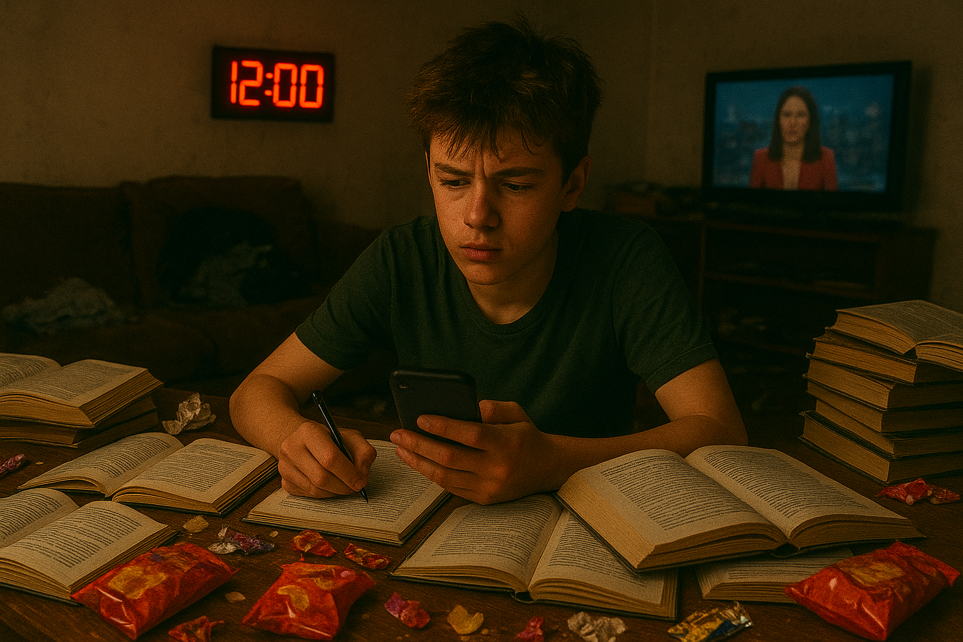
GOOD LEARNER HABITS
EAT A HEALTHY BREAKFAST EVERY DAY – AVOID JUNK FOOD
PUT YOUR MOBILE PHONE AWAY WHILST REVISING
TRY AND REVISE IN AN UNCLUTTERED ENVIRONMENT
PREVENT NOISE AND DISTRACTIONS LIKE THE TV
FOCUS YOUR REVISION – ONE SUBJECT AT A TIME.
GET A GOOD AMOUNT OF SLEEP AND DON’T WORK TOO LATE!

Slide 16

Success at GCSE: Effective Revision Techniques

Slide 17

Days until the first November PPE exam.

Slide 18

School weeks until the first GCSE exam in the hall.

Slide 19
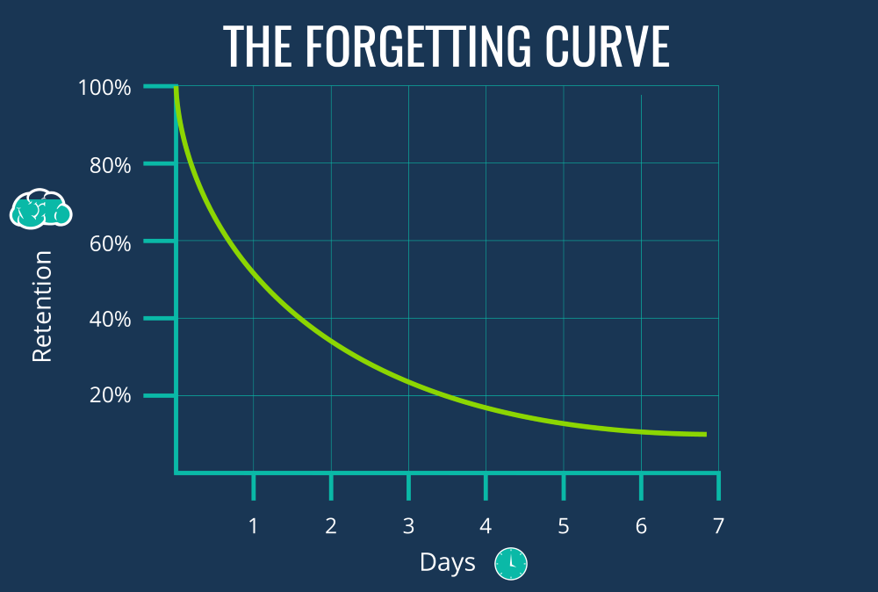

Slide 20
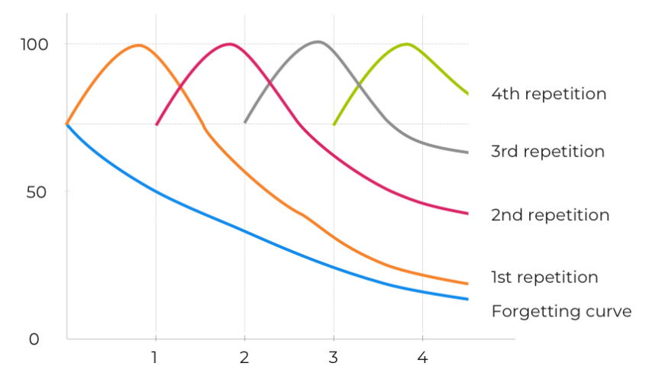
Why is revision important?

Slide 21
Common mistakes and how to avoid them
Sarah spends hours revising. Her main method is making notes from bbc bitesize. She mostly copies down key information.
Neil makes some excellent revision notes. Once he has finished each topic he moves on to the next. He doesn’t have time to go back over these notes before the exam.
Graham revises by reading over his book. He usually also has his phone

Slide 22

Practice! ‘The Core Four'
FLASH CARDS
Kate Jones
SELF QUIZZING
Helen Howell & Ross Morrison McGill
MIND MAPS
Karpicke, J. D., & Blunt, J. R. (2011)
BRAIN DUMPS
Pooja k. Agarwal & Patrice M. Bain
Doug Lemov states, practice does not always make perfect, but it does make permanent.
Students should have a bank of well-practised revision and study methods that they can confidently select from.
(Howell & McGill, 2022)
Notes:
Only then will the fear and anxiety around the word ‘exam’ be reduced, or even transformed by optimism.

Slide 23

Always start with what you remember.

Slide 24




Choose the right task.
I need to re-learn:
Structured notes including mindmaps.
I need to build fluency:
Self-quizzing using flashcards
I am ready to check my understanding:
Past papers*
*Keep a close eye here!

Slide 25

POST -16 options and CHOICES
Parents evening 24/09/25
Explore Dream Discover

Slide 26


Celine Nembhard
Careers and Enrichment Lead cnembhard@deptfordgreen.co.uk
Tel: 0208 469 4896
Do get in touch if you have any queries.

Slide 27

PARTICIPATION AGE- REMINDER
Young people must stay in education or training until they are 18 or to the end of their academic year 13 if they are studying full time.
This is in order to enable them to achieve a full Level 3 qualification by the time they are 19.
This means that in September, after your GCSEs, you must do one of the following until you are, at least, 18:
• Stay in full-time education. For example, at a college, sixth form college, sixth form or UTC
Or
• Start an apprenticeship
Or
• Spend 20 hours or more a week working or volunteering, while in part-time education or training.
Explore Dream Discover

Slide 28

Post 16 Options
WHAT DO WE MEAN BY POST-16?
We are talking about the period directly after you finish secondary school at the age of 16 and following your GCSE exams.
If at any stage of the process of applying and moving on to Post-16 , you are experiencing barriers or difficulties to applying and enrolling and feel you need support or would like further information, advice and guidance, do let us know.
September to December 2025
By January 2026
Between November 25 and May 26
July 2026
August-September 2026
Information and Research
Apply
Offers and Interviews
Induction Day
Results Day and Enrolment
Apply to 3 places
Keep track of deadlines.
Keep a log of where you are applying and to what.
You might be asked to attend a meeting/ interview or upload additional information to your application.
Some institutions will have an induction or taster day.
Double check enrolment information
Results Day is on Thursday 20th August 2026.
Get your results- Celebrate!
ENROL
Complete your destination form after enrolment
Start your next steps. Enjoy!
Attend sixth forms and colleges open events.
Attend your careers meeting.
Explore Dream Discover

Slide 29








DEPTFORD GREEN Y11 OPTIONS EVENING
TALK TO OVER 20 SIXTH FORMS, COLLEGES, UNIVERSITIES
AND TRAINING PROVIDERS IN ONE EVENING
Date: THURSDAY 9th OCTOBER
Time: 5:00 – 7:00pm
Location: Deptford Green School

Slide 30
Sixth forms, Sixth Form Colleges and other organisations, including:
Access Creative
ADA
Big Creative Education
Capel Manor College
Capital City Group Colleges
Christ The King sixth form colleges
ELAM
Goldsmiths University
Haberdashers Hatcham
Harris Academy
Kinetic Football Academy
Lewisham and Southwark Colleges
London Design & Engineering UTC
London Screen Academy
London South Bank University
Sedgehill Sixth Form
SFH6 - Sydenham and Forest Hill School Sixth Form
Shooters Hill Sixth Form College
STAC
The Brit
Thomas Tallis Sixth Form
Explore Dream Discover

Slide 31

Questions to ask yourself and providers
How will this course develop my interests, skills and knowledge?
Am I clear on entry requirements?
How will I be assessed? Coursework and exams? Exams only?
What will my timetable and workload look like?
How much study time do you expect me to put in to achieve a good result?
What are the progression routes after this course? Will this course give me options to progress towards my career goals? What are the programmes in place to support me to achieve my goals?
If I do not have careers goals yet, am I open to opportunities and I am looking at options that can provide them?
What do I need to be motivated? What do I want or not want in order to do my best and develop?
What are the current and potential barriers to my learning that need to be removed to keep me focused and to realise my potential?
What are MY options?
Explore Dream Discover

Slide 32
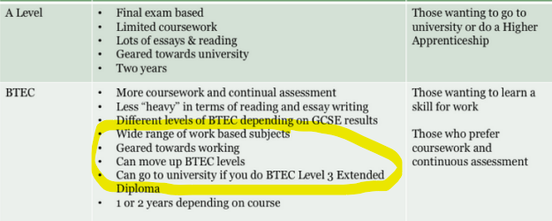
DECISIONS
What type of institution and where?
Which qualification? Level?
School Sixth Form? OR
Sixth form College?
College of Further Education?
UTC?
Specialist School?
Apprenticeship?
Dress Code? Timetable? Journey?
Entry Requirements, Exam and Results?
Explore Dream Discover

Slide 33
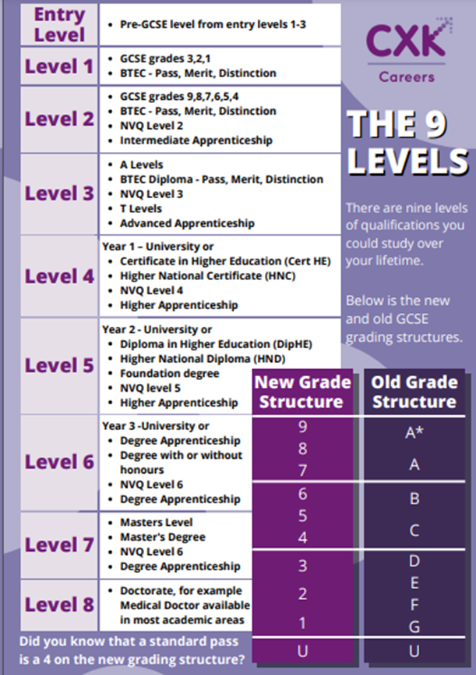
Levels?
Entry level
Level 1- GCSE grades 3-1, BTEC level 1
Level 2- GCSE grades 9-4, BTEC level 2, Intermediate Apprenticeship
GCSES: 5 GCSEs at grades 4+, including English and Maths- LEVEL 2 COMPLETED
Level 3- A Levels, T Levels, BTEC level 3, Advanced Apprenticeship
Level 4-Certificate of Higher Education BTEC professional Diploma, HNC
Level 5-Foundation Degree, BTEC professional Diploma HND, Higher Apprenticeship
Level 6-Bachelor's Degree at University, BTEC professional Diploma, Degree Apprenticeship
Explore Dream Discover

Slide 34
Currently, what are the options after GCSEs?
If you have achieved 5 GCSEs at grade 4/5 and above including English and Maths, you can do either:
A Levels (Usually 3 subjects)
Usually need grade 6 + average inc Eng Lang and Maths and at least grade 6 in the subjects chosen
IB
6 SUBJECTS - Great for students achieving 7+ and do not want to choose between Humanities, Creatives and STEM subjects yet
Extended Diploma (worth three A-levels)
Diploma (worth two A-levels)- can be combined with one A-level in some places
Foundation (subsidiary) Diploma–can be combined with other diplomas or A Levels in some places
T Level (worth 3 A Levels)
Advanced (Level 3) Apprenticeship (worth 2 A Levels)
Earn while you Learn

Slide 35
What can you do next after GCSEs, if you have not yet achieved 5 GCSEs including English and Maths?
You could do:
Level 2 qualification
(1 year)
While retaking English and Maths if needed
Followed by
Level 3 qualification
(2 years)
OR
A qualification at:
Entry Level
Level 1
Level 2
Note:
Most apprenticeships will require you to have a 4 in English and Maths
Explore Dream Discover

Slide 36
PAUSE
T Levels will/ might/ could eventually become one of the main choice for students after GCSE alongside:
Apprenticeships for students who wish to learn a specific occupation ‘on the job’
A levels for students who wish to continue academic education
T Levels offer include:
Craft and design
Design, surveying and planning for construction
Digital production, design and development
Education and childcare
Digital business services
Health
Healthcare science
T Level courses are technical qualifications (equivalent to 3 A Levels) developed with employers to match industry skills demand and include:
Core theory, concepts and skills for an industry area
Specialist skills and knowledge for an occupation or career
Industry placement with an employer
Minimum standard in Maths and English if students have not already achieved them
Explore Dream Discover

Slide 37
M is predicted and then achieved the grades below.
They wants to study A Levels Biology, Chemistry and Maths to do Medicine at University.
5-4 in combined science
5 in English Language
3 in Literature
5 in Maths
5 in Geography
4 in Spanish
5 in Photography
5 in Business
9 GCSE
6 GCSE 5+
It is highly unlikely that M will be offered a place in a sixth form to study A Levels Biology, Chemistry and Maths.
However, if they are keen to pursue their interest in Sciences and Health Care, they could do a BTEC L3 Science or a T Level Healthcare/ Nursing in a sixth form or sixth form college or college and then go to university or do a degree apprenticeship.
K is predicted and achieved the grades below and wants to study A Levels Geography, Biology and Physics.
After sixth form, they might want to do a Degree apprenticeship in Economics with the Civil Service .
5 in Biology
5 in Physics
5 in Chemistry
6 in Maths
8 in English Language
8 in English Literature
7 in Geography
8 in French
8 in Art
9 GCSE
6 GCSE 6+
K is unlikely to be offered a place in a sixth form to do A Levels Biology and Physics.
However, they could do A Levels English Literature, Geography and Economics and then apply for the degree apprenticeship or university.
A is predicted and achieved the grades listed below. They are not sure what they want to do but they think they should go to a sixth form and do A levels. They enjoy the process of designing and making in DT. They enjoy photography and have built a great Art portfolio independently.
3 in Maths
5 in English Language
4 in English Literature
4-4 in Combined Science
4 in Drama
6 in DT
5 in French
6 in Photography
9 GCSE
8 GCSE 4+ but 4 not yet achieved in Maths.
Many sixth forms will not offer a place due to the 3 in Maths.
However, many sixth form colleges would offer a L3 Extended Diploma in Art and Design and Maths retake.
What other courses do you think A. would enjoy and be successful in and for which they would meet the entry requirements?
Let’s think about some common misconceptions and dilemmas
Explore Dream Discover

Slide 38
APPLICATION PROCESS
Like primary, secondary school and university?
APPLY
At the right level, in the right place, at the right time
3 to 5 applications by Christmas
INTERVIEWS AND OFFERS
Check communications
Attend or reschedule
ENROL
You do not have a place until you enrol
Talk to us- Answer communications
Individual application to each provider
In August, on results day, or right after results day
From now
Research
OPEN DAYS
Ask questions
1-2-1
Careers Hub
Engage in the process
Apply
Think
Decide
Use Unifrog
Can you see yourself there?

Slide 39
Timeline
Apply to 3 places by Christmas
If needed apply to 2 more after Christmas
January- April: Check emails - Might be invited to Interview- Might be asked for additional information.
Check emails for offer and conditions- Possibly taster day invitation- and enrolment information
20th August Results Day: Get your results AND ENROL.
September 2026: Start your course, enjoy, tell us where you are. Get in touch asap if there are any issues.
Explore Dream Discover

Slide 40




Visiting sixth forms and colleges is essential to help you decide where you want to go next and what you want to study. Here are some examples of open events coming up
Open Days
Haberdashers Hatcham Sixth Form Open Morning: Saturday 29th November 10:00-12:30
London Nautical City of London Academy 6th Form Open Evening: 12th November 17:00 till 19:00
The Charter North Sixth Form Open Evening: 5th of November 2025 from 16:30 till 19:00
Thomas Tallis Sixth Form OPEN EVENING Wednesday 15 October 2025
STAC Sixth Form Open Evening: Thursday 20th November 2025 External students 16:45 till 17:30
Events
London Design & Engineering UTC Open Evening: 7th October 2025: Click here to book
London Design & Engineering UTC Open Evening: 25th November 2025: Click here to book
London Design & Engineering UTC Open Event: 04th July 2026: Click here to book
Explore Dream Discover

Slide 41

All students have access to Unifrog- they have been sent an invitation by email. Create your password and start using now.
Parents and carers can also create an account to explore pathways and careers and support their child with exploration and recording of skills and experiences.
CV builder, career profiles, work experience guides and more available
To make your parent/ carer account, go to
https://www.unifrog.org/code
and input the sign-up code: DPTFparents
Explore Dream Discover

Slide 42
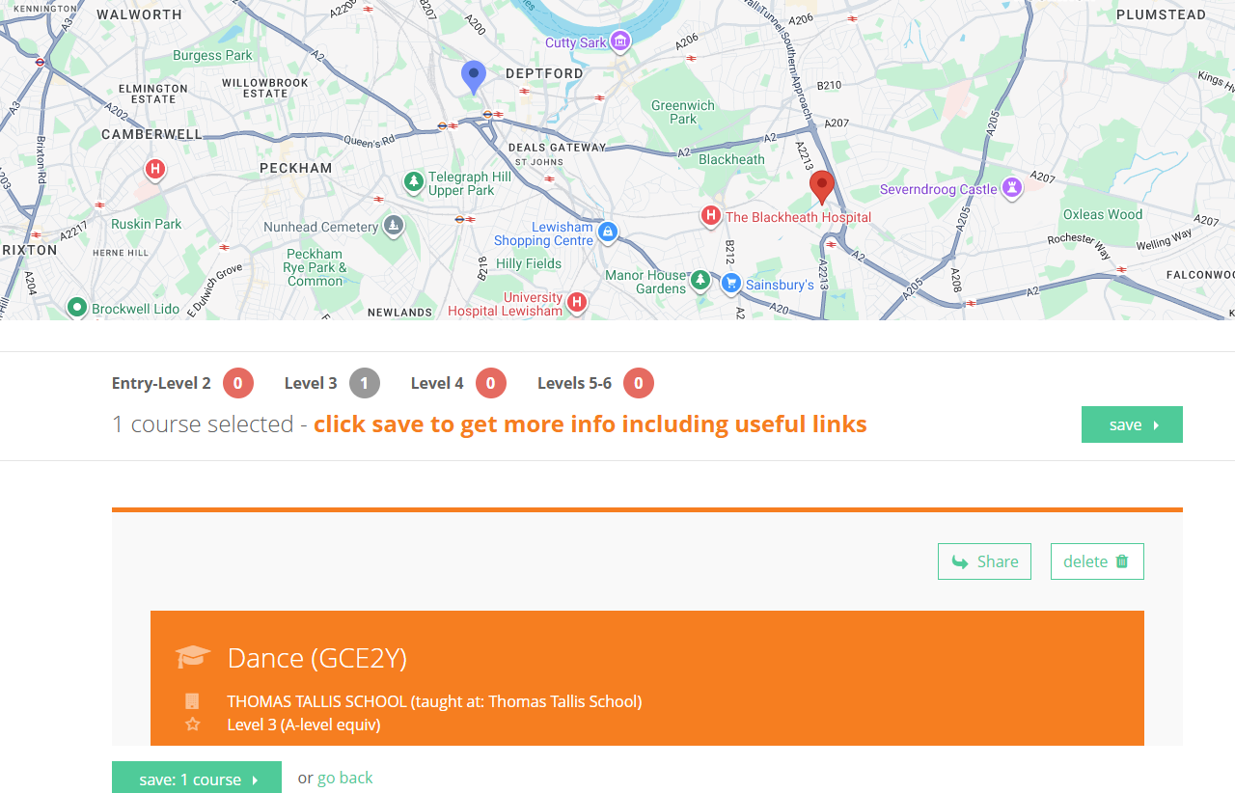
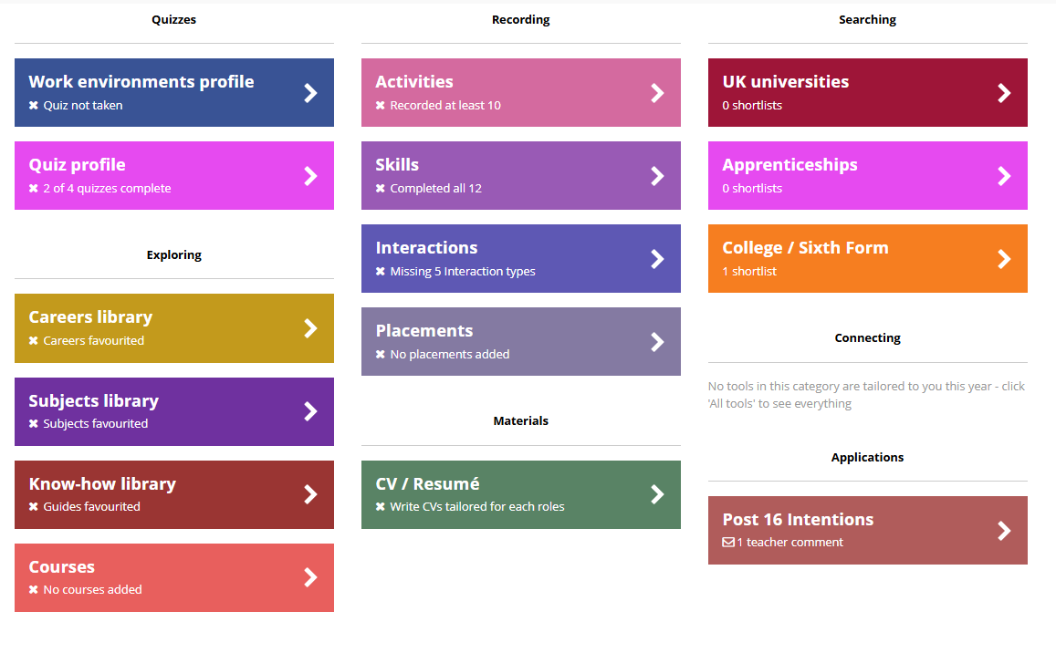
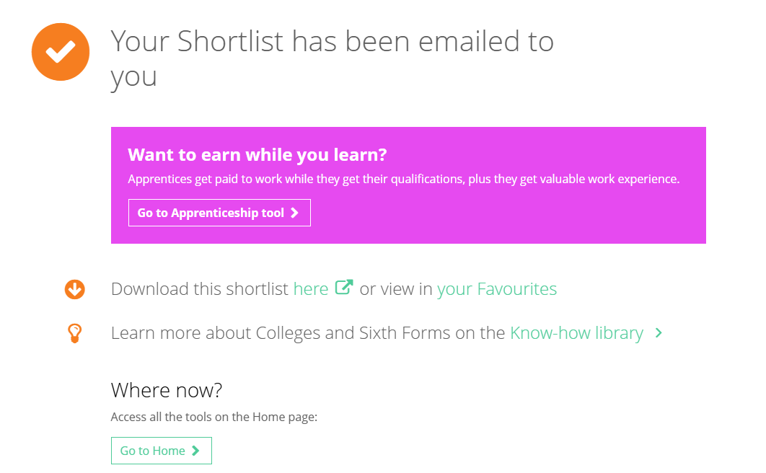
Post-16: Plan A and Plan B
Short list sixth forms and colleges
Careers Meeting invitation and notes

Slide 43
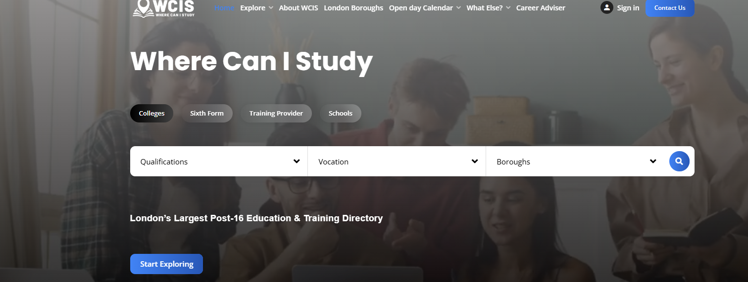
Tools to use:
https://wherecanistudy.co.uk/
Where can I study

Slide 44
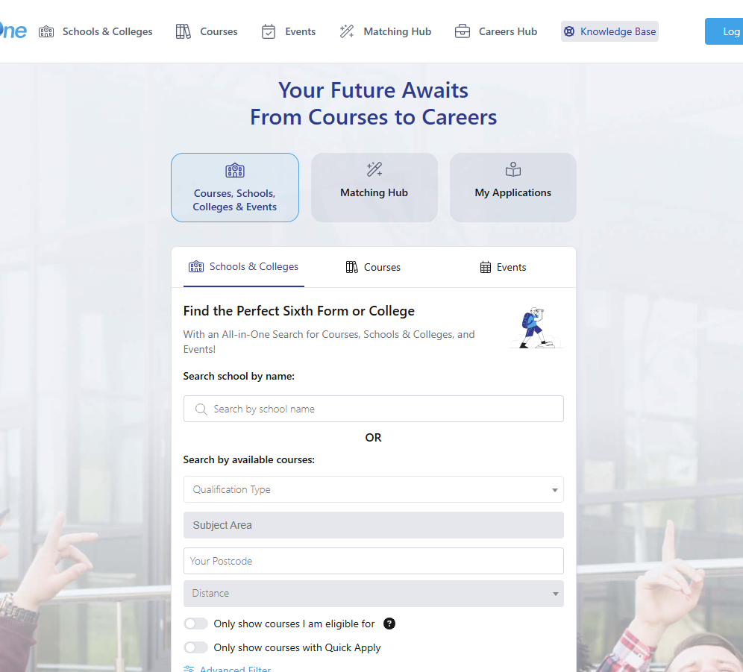
Tools to use:
https://applicaaone.com/
APPLICAAONE

Slide 45
Online application form:
Basic details (address, email, phone…)
Grades (predicted, list them all)
Referee- enter details below: cnembhard@deptfordgreen.co.uk
Tel: 0208 469 4896
Name: Celine Nembhard
Any Questions, get in touch

Slide 46

THANK YOU! Now, over to you!

